Slide 1
Your Company Logo
Powerful and Persuasive

Slide 2
Goals of a Logo
Your logo is a symbol that can provide consumers with instant and powerful brand recognition of your business and the services or products that you offer.
Think of your logo like a small ad for your company - you want to keep your brand message consistent to help increase consumer recognition.

Slide 3
Goals of a Logo cont.
The mission of your logo is to portray the values and goals of your company.
Be clear about the message you want your brand to convey so that your logo can clearly reflect that message.
Your logo should reflect professionalism and growth no matter how small your company is.
Make sure that the logo you select is not dated but can be used effectively year after year.
Keep in mind it is how consumers will recognize your company.

Slide 4





What Company?

Slide 5







What Company?

Slide 6







What Company?

Slide 7




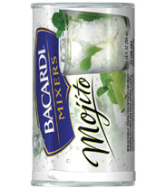





What Company?

Slide 8






What Company?

Slide 9














What Company?

Slide 10


What Company?

Slide 11
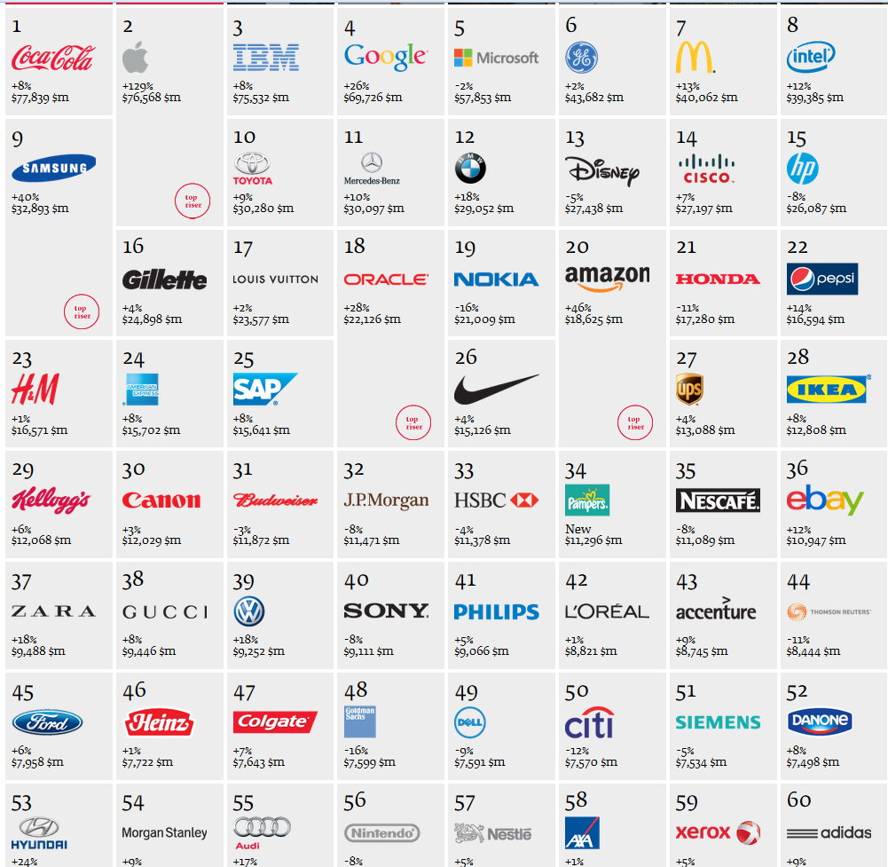
Best Global Brands Report 2012

Slide 12

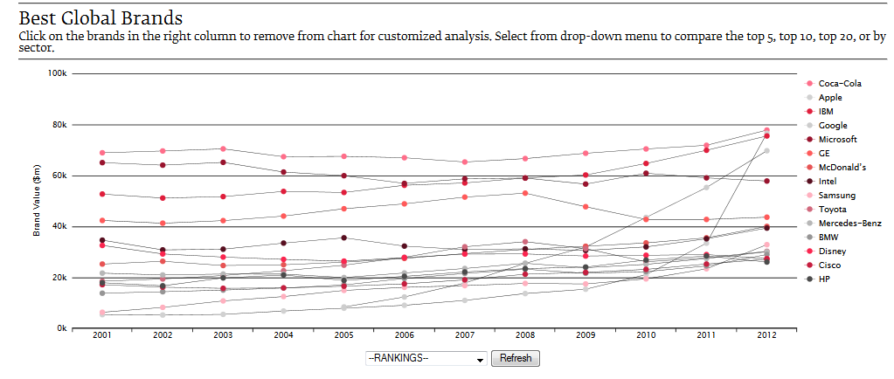
http://www.interbrand.com/en/best-global-brands/2012/Best-Global-Brands-2012-Brand-View.aspx

Slide 13
Your Logo
Be thoughtful!
Be creative!
Have fun!

